Slide 1
Project HR & Stakeholder Management: A Strategic Framework

Slide 2
Rational Culture (Market Culture)
A rational culture, also known as a market culture, is results-oriented and focuses primarily on productivity, performance metrics, and achieving concrete, often financial, outcomes. Success is measured by quantifiable achievements, and a competitive mindset, both internally and externally, is encouraged to drive performance.
Innovative Culture (Adhocracy Culture): An innovative culture, or adhocracy culture, fosters creativity, individual initiative, and an entrepreneurial spirit. It values agility, transformation, and adaptability to dynamic environments. Organizations with this culture encourage risk-taking and experimentation, viewing failure as a learning opportunity. Breakthrough innovations, strategic agility, and long-term growth define success. This culture is often found in tech startups and research institutions.
Developmental Culture (Clan Culture): A developmental culture, also called a clan culture, emphasizes collaboration, teamwork, and strong interpersonal relationships, much like a family or community. It prioritizes employee development, mentoring, and open communication. This culture is effective when employee retention, knowledge sharing, and collaborative problem-solving are crucial for success, and it can also support innovation through psychological safety and shared purpose.
Hierarchical Culture: A hierarchical culture emphasizes control through structure, organization, and a clear chain of command. It values stability, consistency, and adherence to established rules and procedures to ensure dependable and repeatable processes. Decision-making follows a top-down approach, with well-defined roles and responsibilities. This culture works well in regulated industries (like government or healthcare) where consistency, safety, and risk management are paramount

Slide 3
1. Rational Culture (Market Culture)
Focuses on results, productivity, efficiency, competition, and targets
Organization is externally focused (market, customers, competitors)
Success = profit, market share, performance
Key Characteristics
Goal-oriented
Performance measured by KPIs
Managers act like hard drivers
Emphasis on winning and meeting deadlines
Example
A manufacturing firm that:
Rewards employees for meeting production targets
Penalizes delays or cost overruns
Competes aggressively with rivals
Example organizations Include Sales-Driven companies, consulting firms, and private manufacturing firms.

Slide 4
2. Hierarchical Culture
Meaning
Focuses on rules, procedures, stability, and control
Organization is internally focused
Authority flows top-down
Key Characteristics
Clear chain of command
Standard operating procedures (SOPs)
Formal communication
Risk-averse environment
Example
A government department or public university where:
Decisions require multiple approvals
Rules are strictly followed
Employees know exactly “who reports to whom”
Example organizations: Government offices, banks, military, public universities.

Slide 5
3. Innovative Culture (Adhocracy Culture)
Meaning
Focuses on creativity, innovation, risk-taking, and new ideas
Organization is externally focused and flexible
Success = innovation and being first in the market
Key Characteristics
Encourages experimentation
Low formalization
Flexible roles
Accepts failure as part of learning
Example
A tech startup that:
Encourages employees to try new ideas
Invests heavily in R&D
Rapidly launches new products
Example organizations: Technology startups, R&D labs, product design firms.

Slide 6
4. Developmental Culture (Human Relations / Clan Culture)
Meaning
Focuses on people development, teamwork, trust, and learning
Organization is internally focused and flexible
Success = employee satisfaction and skill growth
Key Characteristics
Strong teamwork
Mentoring and coaching
High employee involvement
Emphasis on training and growth
Example
A training-oriented company where:
Employees receive continuous learning
Managers act as mentors
Collaboration is encouraged
Example organizations: Educational institutions, NGOs, HR-focused firms.

Slide 7
Aspect | Rational Culture | Hierarchical Culture | Innovative Culture | Developmental Culture
Main Focus | Results & productivity | Stability & control | Innovation & creativity | People development
Orientation | External | Internal | External | Internal
Flexibility | Low | Very low | High | High
Decision Making | Performance-based | Rule-based | Experimental | Participative
Leadership Style | Task-oriented | Authority-driven | Visionary | Mentoring
Risk Taking | Low | Very low | Very high | Moderate
Key Success Measure | Profit, targets | Efficiency, consistency | New ideas, growth | Employee satisfaction
Communication | Formal, target-driven | Very formal | Informal | Open & collaborative
Example Organization | Sales firm | Government office | Tech startup | Training institute

Slide 8
The historical perception of HR as a reactive cost center can be overcome by adopting a Project Management mindset. In the new model, the organization's talent needs are managed as critical projects, with HR acting as the project leader responsible for managing the organizational resources including utilities, employees, materials and ensuring effective buying to ensure key stakeholders
Action for Project HR: HR must not wait for the market to shift to become relevant. It must actively manage stakeholder expectations by consistently demonstrating value, mainly when labor is plentiful. It has A, B, and C categories

Slide 9
A. Define & Initiate the Talent Project (The Strategic Agenda)
This is about defining the project scope and securing executive offers before a crisis hits.
Set the Agenda: HR must be the one to articulate a point of view on every people-related topic (e.g., layoffs, recruiting, performance management) and show how it matters to the business.
Acquire Business Knowledge: Use first-rate knowledge minds to mine employee data (the "Project Resource Information") to inform decisions. This is key to turning talent management into a data-driven business decision.
Manage Financial Stakeholders (ROI): Translate talent programs into clear financial benefits (Project Justification). Don't just focus on soft outcomes like job satisfaction. Try to calculate ROI for HR initiatives.

Slide 10
B. Plan the Talent Project (Focus & Context)
Project plans must be tailored to the immediate and specific context of the organization, not generic templates.
Focus on the Here and Now: Stop copying outdated playbooks. The plan must be company-specific and industry-specific.
Adopt Contextual Practices: Follow the lead of companies who are moving away from traditional, reviled practices (e.g., appraisals) toward flexible, ongoing conversation models that meet the specific needs of their key talent.
Risk Management (Time Wasters): Identify and "walk away" from low-impact initiatives that drain time and social capital with line managers.

Slide 11
C. Execute & Monitor the Talent Project (Implementation & Alignment)
This is where HR works with line managers to ensure the talent plan is executed and monitored for results.
Empower Line Managers (Project Leadership): Recognize that line managers are pushed to follow procedures without HR having direct power. The goal is to make them take their supervisory responsibilities more seriously.
Align Short-Term with Long-Term: Reconcile/resolve the short-term with the long-term nature of talent development, turnover, and culture-building. HR must study short-term initiatives in the aggregate to spot emerging needs
Control/Corrective Action: Use analytics to monitor the effectiveness of practices e.g., using an algorithm to identify employees likely to break rules to ensure project goals are met.

Slide 12
The Project HR and stakeholder Outcome: Sustained Success
By managing talent through a project lens, HR shifts its role from administrator to strategic partner. The ultimate deliverable is maximizing mandatory/discretionary effort, thus employees who are engaged and willing to give their best will eventually lead to opt for organizational success and/or a direct driver of profitability.

Slide 13
Fundamental Attribution Error (FAE)
The FAE is the tendency to overemphasize internal factors (a person's personality, character, or disposition) and underestimate external factors (situational context or environment) when judging the behavior of others.
Key Concepts to learn
Internal vs. External Attribution:
  Internal: "Jane missed the deadline because she is lazy/incompetent." (FAE occurs here)
  External: "Jane missed the deadline because the IT system was down for two days."
The Reverse Bias: We often do the opposite when judging our own failures (attributing them to external factors).
Impact on HR: This error leads managers to unfairly punish or fire employees without investigating situational causes, poisoning performance reviews.
  FAE Reaction: What's your immediate thought? ("They aren't a good fit for the job.")
  HR Reaction: What external factors should you investigate before judging? (Staffing levels, training, new software interface, etc.)

Slide 14
Job Characteristics Model
Developed by Hackman and Oldham, the JCM is a seminal theory in job design. It posits that a job's structure, or its inherent characteristics, directly impacts employee motivation, satisfaction, and performance by creating specific critical psychological states. This is crucial for designing meaningful work.
Key Concepts to Teach
The JCM links five Core Job Dimensions to Critical Psychological States, which then lead to desired Personal and Work Outcomes.
Core Job Dimensions
Skill Variety
Task Identity
Task Significance
Autonomy/self-rule
Feedback

Slide 15
The Psychological Contract
The Psychological Contract (PC) is the unwritten set of expectations that exists between an employee and the organization. It's not a legal document but a powerful driver of motivation, commitment, and, if violated, organizational conflict and turnover. This is a highly relevant, modern HRM concept.
Contract Breach or open: Occurs when an employee perceives the organization has failed to fulfill one or more promises (written or unwritten). This is purely perceptual.
Contract Violation: The emotional reaction (anger, betrayal) that follows a serious breach. This is a strong predictor of employee disengagement and turnover.

Slide 16
Conflict Management The most common Sources of conflicts are following the schedule, fixing priorities of project activities, assigning resources, technical beliefs of team members, administrative policies and procedures, fixing the project costs, and differences in personalities of team members.

Slide 17
Dealing with the conflict.
1. Compromising: Hearing problems from all the parties and providing solutions that satisfy all the parties, and all the parties are compromised and agree on the project manager.
2. Withdrawal: The project manager temporarily withdrawing from the conflict assumes that the conflict will resolve among the team itself over a period of time, or for better preparation by the project manager.
3. Smoothing: project manager is calming both the parties by focusing on points which are agreeable to all the parties rather than on differences, but the problem will again resurface when these team do the same process next time.
4. Forcing: The project manager is not listening to anyone and forcing the team to do as he says.
5. Confronting: Researching on all points of view of the problem and finding the solution from a different perspective in a practical and professional manner.

Slide 18
The Strategic Management Process
Strategic management
  The process of identifying and executing the organization’s mission by matching its capabilities with the demands of its environment.
Strategy
  A strategy is a course of action.
  The company’s long-term plan for how it will balance its internal strengths and weaknesses with its external opportunities and threats to maintain a competitive advantage.

Slide 19
Strategic Management Process
Strategic management tasks
  Step 1: Define the Business and Its Mission.
  Step 2: Perform External and Internal Audits
  Step 3: Translate the Mission into Strategic Goals.
  Step 4: Formulate a Strategy to Achieve the Strategic Goals.
  Step 5: Implement the Strategy.
  Step 6: Evaluate Performance

Slide 20
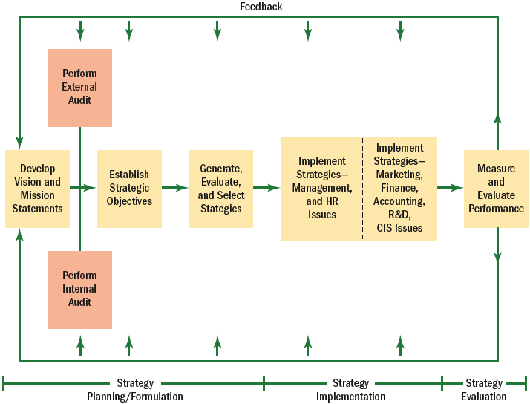
Overview of Strategic Management

Slide 21
Types of Strategic Planning
Corporate-level strategy …Identifies the portfolio of businesses that, in total, comprise the company and how these businesses relate to each other.
Diversification strategy implies that the firm will expand by adding new product lines.
Vertical integration strategy means the firm expands by, perhaps, producing its own raw materials, or selling its products directly
Consolidation strategy reduces the company’s size.
Geographic expansion strategy takes the company abroad.

Slide 22
Strategic Human Resource Management
  The linking of HRM with strategic goals and objectives in order to improve business performance and develop organizational cultures that foster innovation and flexibility.
  Formulating and executing HR systems—HR policies and activities—that produce the employee competencies and behaviors the company needs to achieve its strategic aims.
HR and Competitive advantage
  Any factors that allow an organization to differentiate its product or service from those of its competitors to increase market share.
  Superior human resources are an important source of competitive advantage

Slide 23
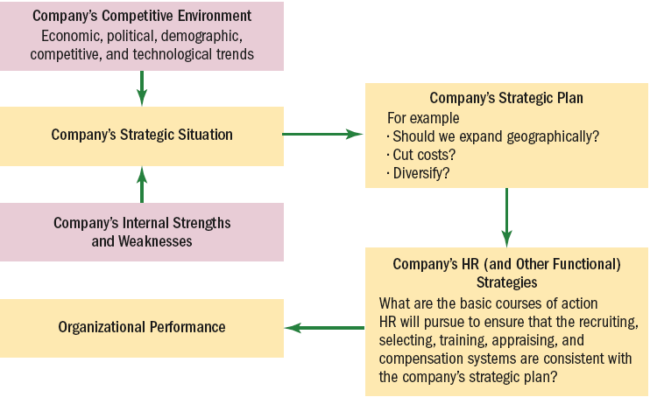
Linking Corporate and HR Strategies
Figure 3–6

Slide 24
HR’S Strategic Roles
HR professionals should be part of the firm’s strategic planning executive team.
  Identify the human issues that are vital to business strategy.
  Help establish and execute strategy.
  Provide alternative insights.
  Are centrally involved in creating responsive and market-driven organizations.
  Conceptualize and execute organizational change.

Slide 25
HR’s Strategy Execution Role
The HR department’s strategies, policies, and activities must make sense in terms of the company’s corporate and competitive strategies, and they must support those strategies.

Slide 26
HR’s Strategy Formulation Role
HR helps top management formulate strategy in a variety of ways by.
  Supplying competitive intelligence that may be useful in the strategic planning process.
  Supplying information regarding the company’s internal human strengths and weaknesses.
  Build a persuasive case that shows how—in specific and measurable terms—the firm’s HR activities can and do contribute to creating value for the company.

Slide 27
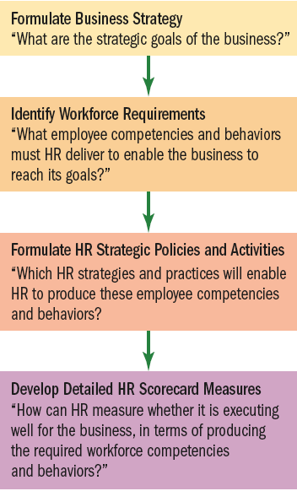
Basic Model of How to Align
HR Strategy and Actions with Business Strategy
Translating Strategy into HR Policy and Practice

Slide 28

THREE IMPORTANT STRATEGIC HR TOOLS

Slide 29
1. STARTEGY MAP
Graphical tool that summarizes the chain of activities that contribute to the company’s success, and shows employees the “big picture” of how their performance contributes to achieving the company’s overall strategic goals.

Slide 30
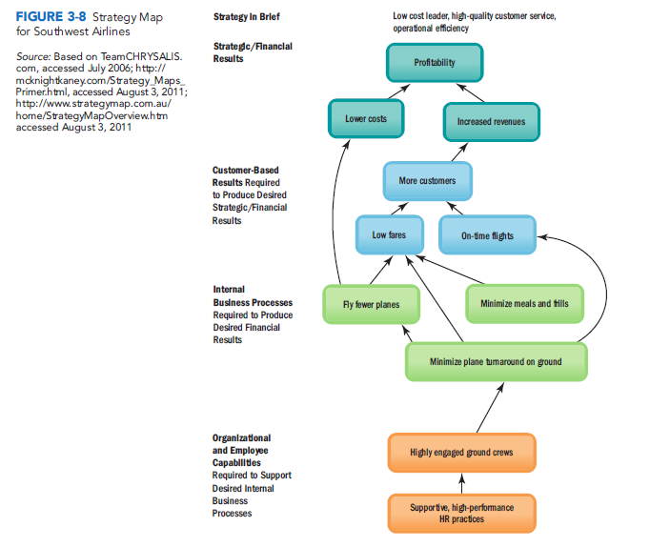

Slide 31
2. HR SCORECARD
A process for managing employee performance and for aligning all employees with key objectives, by assigning financial and non-financial goals, monitoring and assessing performance, and quickly taking corrective actIon.
The HR Scorecard is intended as an easy way for HR teams to measure the effects of their policies on the organisation’s financial performance.

Slide 32
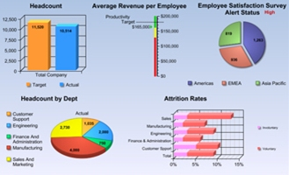
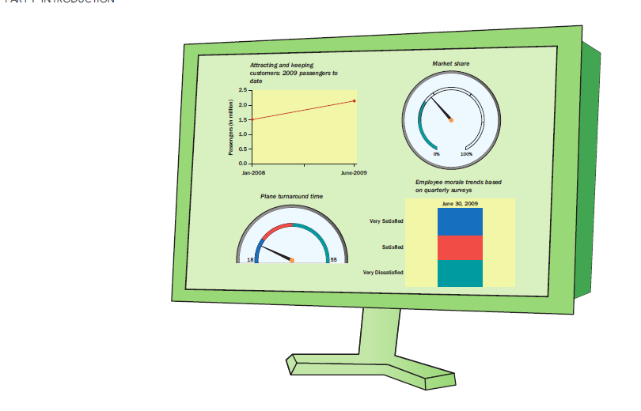
3. DIGITAL DASHBOARD
The saying that a picture is worth a thousand words explain the purpose of digital dashboards.
It presents the manager with desktop graphs and charts, so he or she gets a picture of where the company has been and where it’s going. In terms of each activity in the strategy map.

Slide 33
Strategic HR Relationships
HR
Activities
Emergent Employee Behaviors
Strategically Relevant Organizational Outcomes
Organizational Performance
Achieve Strategic Goals
Figure 3–10

Slide 34
Training and Development
Training is a planned attempted by an organisation to facilitate employee learning of job-related, knowledge, skills and behaviours.
Development refers to enhance the skills needed for both present and future jobs.

Slide 35
NEED FOR TRAINING
The need for training arises because of the following reasons:-
CHANGING TECHNOLOGY: Technology is changing at a fast place. The workers must learn new techniques to make use of advanced technology. Thus, training should be treated as a continuous process to update the employees in new methods & practices.
QUALITY CONSCIOUS CUSTOMERS: The customers have become quality conscious & their requirements keep on changing. To satisfy the customers, quality of products must be improved through training of workers.
GREATER PRODUCTIVITY: It is essential to increase productivity &reduce cost of production for meeting competition in the market. Effective training can help increase productivity of the workers.

Slide 36
STABLE WORKFORCE: Training creates a feeling of confidence in the minds of the workers. It gives them at the workplace. As a result, labour turnover & absenteeism rates are reduced.
INCREASED SAFETY: Trained workers handle the machines safely. They also know the use of various safety devices in the factory. Thus, they are less prone to industrial accidents.
BETTER MANAGEMENT: Training can be used as an effective tool of planning and control. It develops skills among workers for the future and also prepares them for promotion. It also helps to increase productivity and quality.

Slide 37
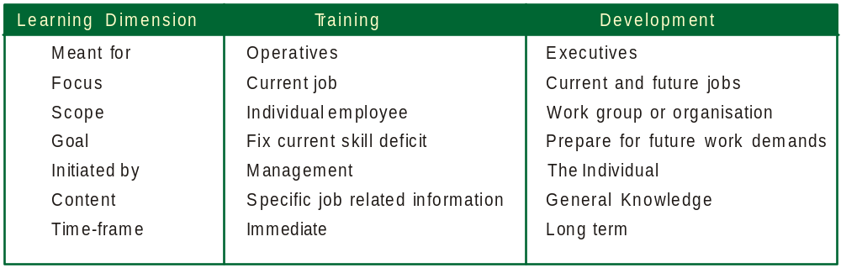
Training vs. Development
Training is concerned with teaching specific job related skills and behaviour. Development is future oriented training, focusing on the personal growth of the employee.
Training vs. Development

Slide 38

Secret of Pixars successful computer animated films.
a. All employees must have freedom to communicate to other employees.
b. Safe for everyone to offer ideas.
c. the company must stay close to innovations occurring in the academic community.

Slide 39
Pixar Braintrust
Pixar developed the "Pixar Braintrust," the studio's primary creative development process, in which all directors, writers, and lead storyboard artists at the studio look at each other's projects regularly and give each other very candid "notes" .The Braintrust operates under a philosophy of a "filmmaker-driven studio", in which creative ones help each other move their films forward through a process somewhat like peer review, as opposed to the traditional Hollywood approach of an "executive-driven studio“
Pixar university offers a collection of in-house courses for training and cross-training employees within their specialty areas.

Slide 40
A Systematic Approach To Training
A systematic approach to training would consist of three phases: training needs assessment, implementation and evaluation
Training needs assessment
Training efforts must aim at meeting the needs of the organiation and the individual employees. This, essentially, involves three types of analysis:
a. Organisational analysis: This is a study of the entire organization in terms of its objectives, utilization of resources to achieve objectives etc.
b. Task or role analysis: This is a detailed examination of a job, its components, its various operations, and the conditions under which it has to be performed.
c. Person analysis: here the focus is on the individual in a given job; whether training is needed, whether the employee is capable of being trained, and the areas where the training is needed.

Slide 41
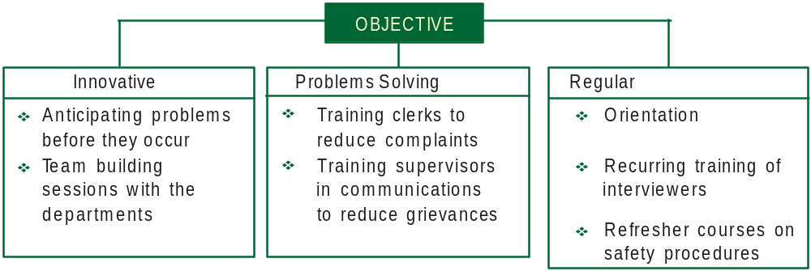
Objectives of training

Slide 42
METHODS OF TRAINING & DEVELOPMENT
COACHING: Coaching is an important and potentially effective approach if coach is properly trained and oriented. The technique involves direct personnel instruction and guidance, usually, with extensive demonstration and continuous critical evaluation and correction. The advantage is increased motivation for the trainee.
MENTORING: The use of an experienced person to teach and train someone with less knowledge and experience in a given area is known as mentoring. The mentor nurtures, supports and guides the efforts of young persons by giving appropriate information, feedback and encouragement whenever required.

Slide 43
ROLE PLAYS: Role plays have trainees act out the character assigned to them. Information regarding the situation (Work or interpersonal problem) is provided to them.
CASE STUDY: This technique, which has been developed and popularised by the Harvard Business School, U.S.A. is one of the most common form of training. A case is a written account of a trained reporter or analyst seeking to describe an actual situation. This method increases the trainee's power of observation, helping him to ask better questions and to look for a broader range of problems.

Slide 44
Learning Organisation
A learning organisation is one whose employees continously learn new things and to use what they learn to improve product or service quality.

Slide 45
Learning Organisations
Organisation learning is a process of detecting and correcting errors.
(Chris Argyris)
Organisations where people continually expand their capacity to create the results they truly desire, where new patterns of thinking are nurtured, where collective aspiration is set free, and where people are continually learning.
(Peter Senge)

Slide 46
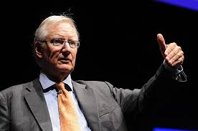
Managing Change
To meet the demands of the fast-changing competitive scene, we must simply learn to love change as much as we have hated it in the past.
(Tom Peters)

Slide 47
Organizational Change Management
What is Organizational Change?
  It is generally considered to be an organization-wide change, as opposed to smaller changes such as adding a new person.
  It includes the management of changes to the organizational culture, business processes, physical environment, job design / responsibilities, staff skills / knowledge and policies / procedures. E.g paperwork
  When the change is fundamental and radical, one might call it organizational transformation

Slide 48
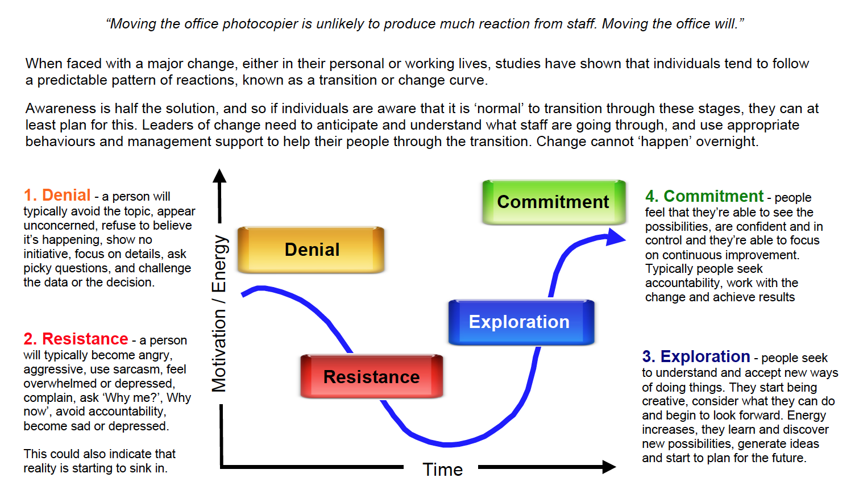
Organizational Change Management

Slide 49

Lessons from Potato
Ice Breaker
People are like….it is not going to happen.
Stupid idea…But all great ideas were considered once stupid.
I want to see others succeeding first.
If they succeed I will join then

Slide 50
Organizational Change Management
How prevalent is Resistance to Change?
  It is generally acknowledged that in an average organization, when the intention for change is announced:
    . 15% of the workforce is eager to accept it
    . 15% of the workforce is dead set against it
    . 70% is sitting on the fence, waiting to see what happens

Slide 51
Overcoming Resistance to Change
What causes resistance?
  All behavior in organizations is a product of two kinds of forces—those striving to maintain the status quo and those pushing for change.
Lewin’s Change Process
  Unfreezing: reducing the forces striving to maintain the status quo.
  Moving: developing new behaviors, values, and attitudes, sometimes through structural changes.
  Refreezing: reinforcing the changes.

